Slide 1

PRESENTATION ON FINAL YEAR B.TECH PROJECT

Slide 2
Bookworld
An e-commerce website for the sale and purchase of all kinds of books of all categories.
Created By-Utsav Tyagi(1723110117)
Sourav Das(1723110106)
Shoyab(1723110100)
Vishakha Bansal(1723110122)
Shivam Tyagi(1723110097)

Slide 3
Contents of Presentation
What is Bookworld?
Objective
Tools and Technologies
Advantages and limitations
Features
Application Modules
Future Scope

Slide 4
What is BookWorld?
1.Bookworld is an online bookstore web project that acts as a central database containing various books in stock along with their title, author and cost.
2.This project is a website that acts as a central book store.
3. This web project is developed using html, css and javascript as the front end and react js,,node js as a back-end.
4. The database stores various book related details. A user visiting the website can see a wide range of books arranged in respective categories.
5. The user may select desired book and view its price.
6. The user may even search for specific books on the website. Once the user selects a book , he then has to add the book to the cart and then checkout by entering the required details.

Slide 5
Objective
1. To build an online bookshop for People that will contain stories, study material, any courses books like computer and be available to everyone.
2. Many students find textbooks too expensive to buy at school bookstores and many courses only use the required textbooks a few days in a semester. This becomes very wasteful and frustrating for students & others people.This online bookstore provides a solution to this.
3. To provide a service in which students can buy books online without any trouble.
4. To provide books without shipping fee.
5. To let people buy books without any hustle of registration.
6. To introduce easy and convenient payment methods.
7. To provide the facility for selling the books online if someone wants to sell his/her creation.

Slide 6



Tools and Technologies
1. Tools :
Visual Studio Code
Notepad++
Node Js

Slide 7




Tools And Technologies
1. Technologies :
HTML
CSS
REACT
FIREBASE

Slide 8
Advantages and Limitations
Advantages :
• Customers can get their book delivered instead of actually going and buying the book. They can make payment online itself.
• Managing of inventory in the shop for shopkeeper becomes easier as customers are not visiting and ordering online.
• This system saves both time and travelling cost of customers.
• User can get to know different kinds of books that they were unaware of by just searching in the system using keywords.

Slide 9
Limitations :
1. The Website is not accessible to everyone. It can be deployed on a web server so that everybody who is connected to the Internet can use it.
2. Credit Card validation is not done. Third party proprietary software can be used for validation check.

Slide 10
Features :
Sign Up: Allows the user to register himself on the website.
Sign In: Allows access to already registered users.
Home Page: All the necessary information is present.
Dashboard: Where sellers can sell their book by filling necessary details.
Buy Books: Allows user to purchase any book from the given books.
Books Category: Allows user to search books based on category or class.
Add to Cart: Allows user to add the chosen book to his/her cart.
Wishlist: Allows user to make a wishlist of books of his choice.
About Us: Allows user to know about the creators and contact them.

Slide 11
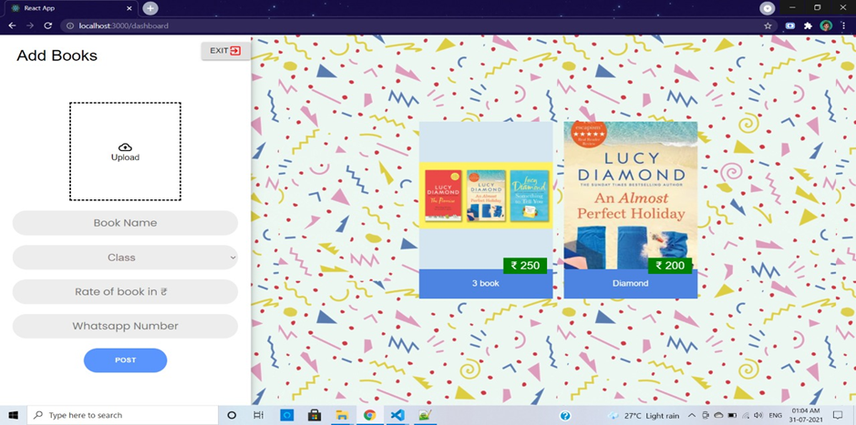
Application Modules
1. Dashboard

Slide 12
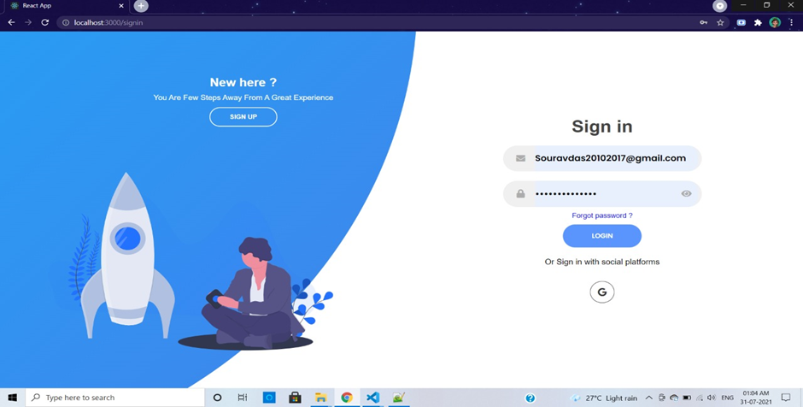
Application Modules
2. Sign in

Slide 13
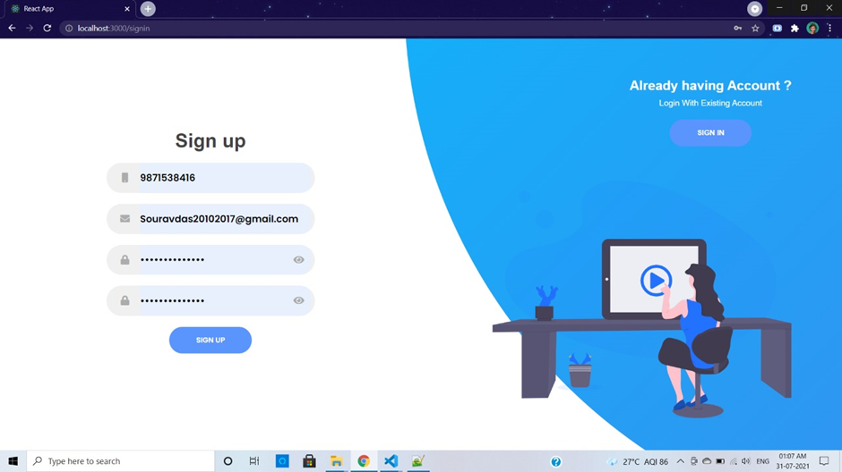
Application Modules
3. Sign up

Slide 14
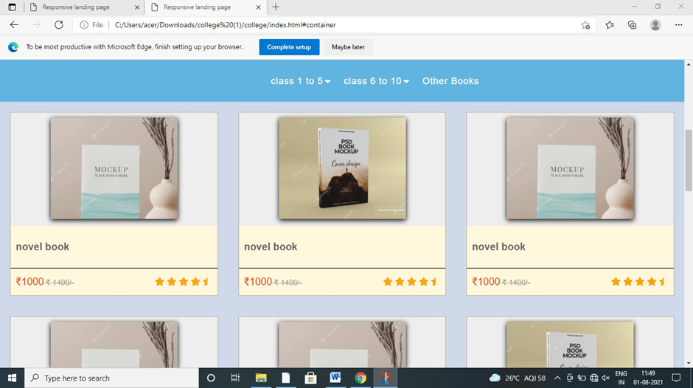
Application Modules
4. Home Page

Slide 15
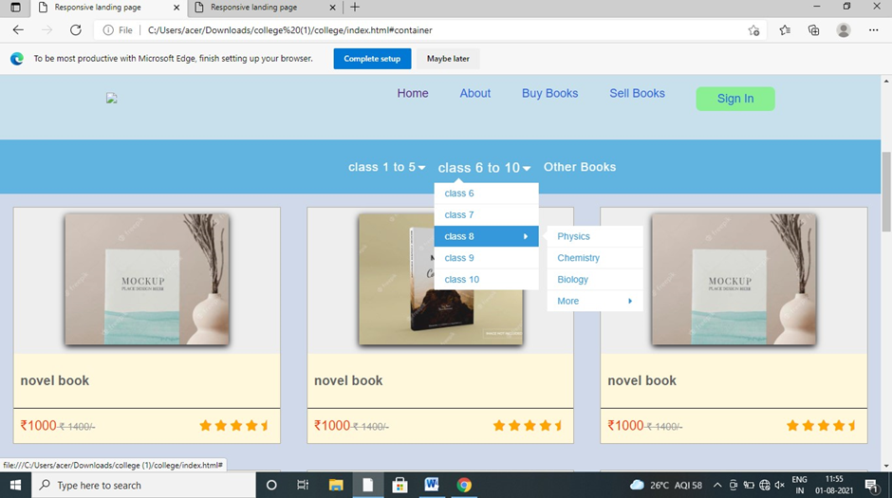
Application Modules
5. Books Category

Slide 16
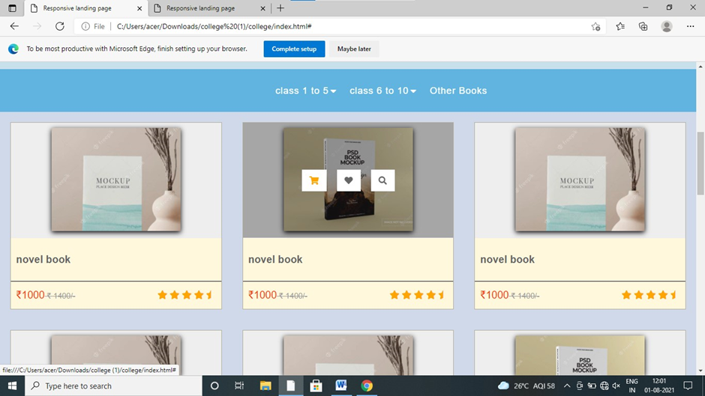
Application Modules
6. Multiple Options
a. Add to cart
b. Wishlist

Slide 17
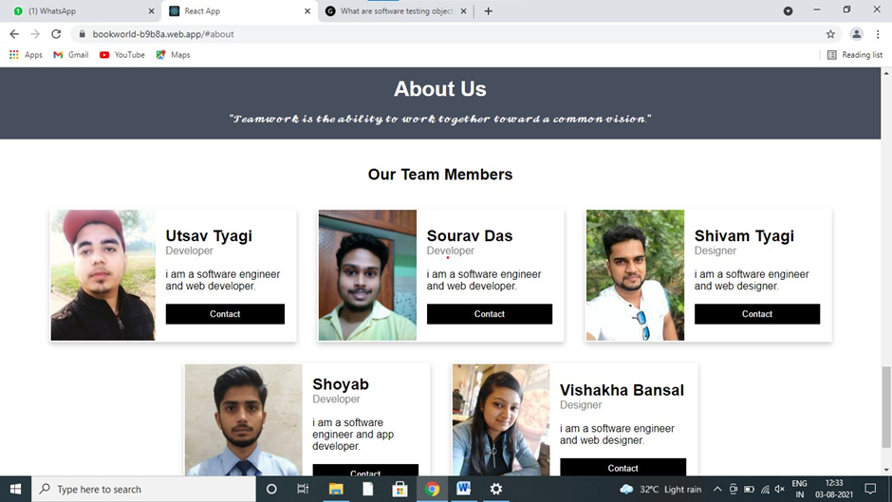
Application Modules
7. About Us

Slide 18
Future Scope
1. The Administrator of the web site can be given more functionality, like looking at a specific customer’s profile, the books that have to be reordered, etc.
2. Multiple Shopping carts can be allowed.
3. Credit Card can be added as a payment method as a future development.

